Slide 1
Development of a mobile app and web app for the Co-operative society of baze university
Anikwenze Olisa Harry
BU/21c/IT/5648

Slide 2
Introduction
The co-operative system gives the members of the co-operative to perform their numerous activities using cutting edge technologies to deliver the utmost performance.

Slide 3
Problem Statement
Members can’t see their balance at all times
Members can’t keep track of their activities in the society
It is difficult for the executive members to approve/ decline loan requests and registration requests
The loan request process is a bit tedious

Slide 4
Aims and objectives
The main objective of the apps is to develop a system that directly streamline the activities of the co-operatives by-
To Allow members of the Co-operative to request loans.
To allow executive members to approve/decline loan requests and registration requests.
To allow the admin to suspend or activate members.

Slide 5
Significance of Project
Faster feed back on members requests
Streamline the loan request process
Provide a webapp that allows the admin to have an overview of all activites on the system

Slide 6
Literature Review
Related Work | Features | Weaknesses
Co-opify | Allows, requesting for loans and adding savings. | Admin performs activities on behalf of members.
Co-opco | Said to support Member Registration | Poorly managed system
Electric Cooperatives FCU | users can see their account balance at any time. | The system is more suited as a personal banking application and doesn’t allow collaboration among members.
(Olorunlomerue et al, 2017) | Registration of co-operatives on a national level | The system wasn’t scalable enough to store data on the whole country
(Onyeama et al, 2017) | Management of short- and long-term loans | There was high Complexity in monitoring all loans

Slide 7
Methodology
Waterfall Model and Rapid prototyping- the waterfall model was selected for the development of the project.
Requirements were gathered from the end user and based on the requirements, the system was developed to meet as many functional requirements as possible.

Slide 8
Tools and Techniques
React
React Native
Nodejs
MongoDB

Slide 9
Functional Requirements
Req. No | Description
R-1 | The system should allow users to view their savings balance and loan balance.
R-2 | The system should allow users who have taken out loans should see the deadline for the loan anytime.
R-3 | The system should allow users to request for loans; they should always see the status of the loans and get an email in a case where the loan is either approved or denied.
R-4 | The system should allow users to log in/Sign out.
R-5 | The system should allow users to register; giving only minimal information.
R-6 | The system should notify users when their request to join the co-operative (after registering) has been approved or denied.

Slide 10
Non-functional Requirements
Req. No | Description | Type
R-301 | The system shouldn’t quit randomly after the user opens it and must stay active until closed or some hardware failure. | performance
R-302 | Users should be able to use the system at any time of the day if they have internet connectivity. | Availability
R-303 | The system should give results quickly if the result doesn’t rely on user input. | Performance
R-304 | The system should only provide data and prompts associated to an account to whoever has authorized access to the account. | Authorization
R-305 | The system should be properly run across numerous smartphones (for the mobile app) and laptops/desktops (web application). | Portability
R-306 | The system should CPU and memory resources in an effective manner. | Efficiency

Slide 11
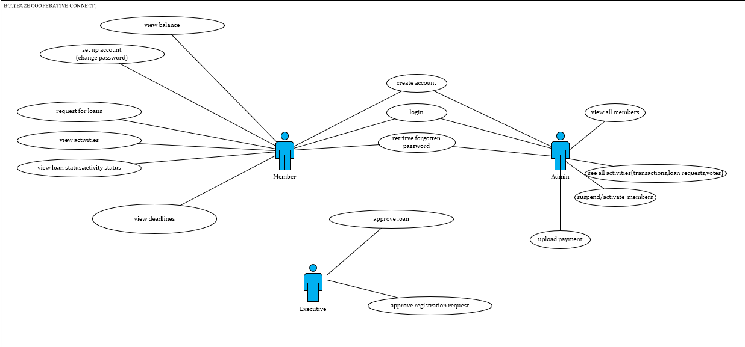
Use case diagram
Use case diagram

Slide 12
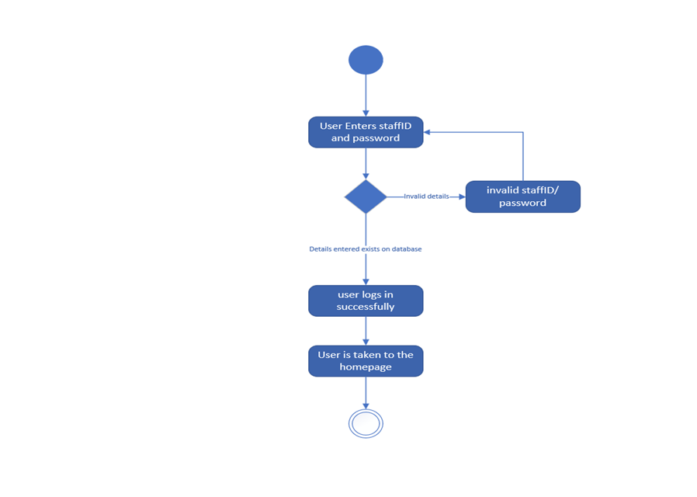
Activity diagram
Figure 1.2
Activity diagram for member login

Slide 13
Figure 1.3
Activity diagram showing registration process

Slide 14
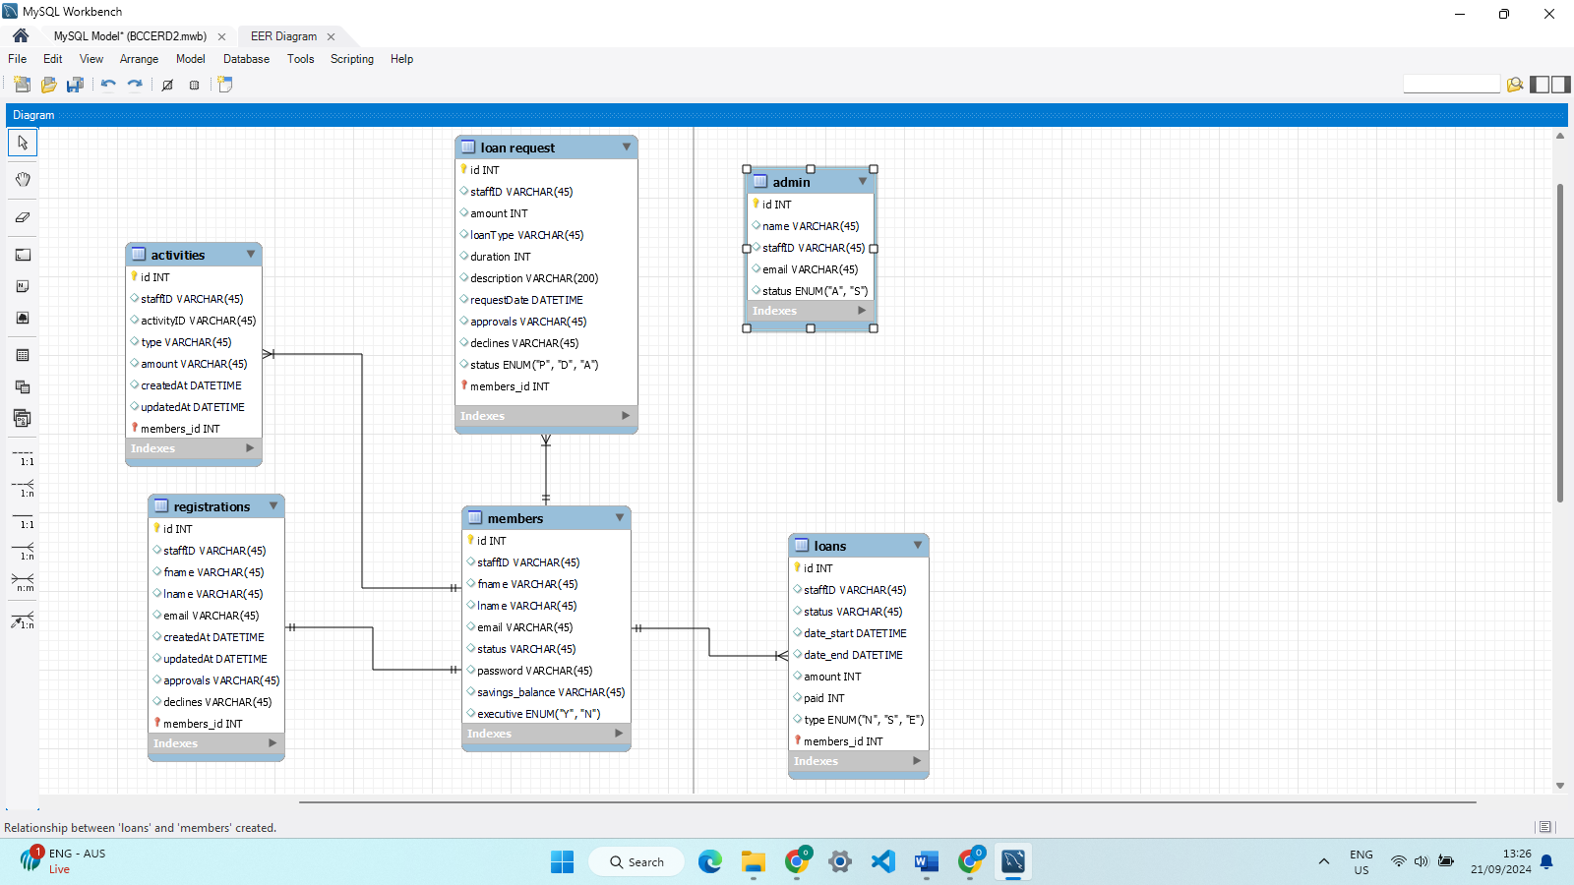
Figure 1.4 entity relationship diagram

Slide 15
Testing
Table 4.1 Test Summary for user registration
Test Case | User Registration
Related requirements | R-5
Prerequisites | User should be able to access the main login/register page
Test procedures | Click on the “Register” toggle button Enter valid signup details Click on “Register” button
Test Data | Users Valid details
Expected Results | Registration sent to executive
Actual Result | Registration information was sent to executives view
Status | Pass
Remarks | None
Created by | Anikwenze Olisa Harry
Date of creation | 23rd August 2024
Executed by | Anikwenze olisa Harry
Date of execution | 23rd August 2024
Test environment | Hp laptop

Slide 16
Table 4.2 user login testing
Test Case | User login
Related requirements | R-4
Prerequisites | User should be able to access the main login/register page, member account must be active
Test procedures | Click on the “login” toggle button Enter valid staff-id and password Click on “login” button
Test Data | Valid staff id and password
Expected Results | Member should be taken to the home page where they can see their loan and savings balance
Status | Pass
Remarks | None
Created by | Anikwenze Olisa Harry
Date of creation | 23rd August 2024
Executed by | Anikwenze olisa Harry
Date of execution | 23rd August 2024
Test environment | Hp laptop

Slide 17
Table 4.3 user loan request
Test Case | User loan request
Related requirements | R-3
Prerequisites | Member is logged in Member has paid over half of their current loans Member has an active account
Test procedures | Navigate to loan requests page Select loan type Enter loan amount and select duration Optionally enter reason for loan request
Test Data | Amount must be a number, duration must correlate with loan type,
Expected Results | Loan request should be stored in database and shown to the executive
Status | Pass
Remarks | None
Created by | Anikwenze Olisa Harry
Date of creation | 23rd August 2024
Executed by | Anikwenze olisa Harry
Date of execution | 23rd August 2024
Test environment | Hp laptop

Slide 18
Conclusion
The developed applications meet the requirements of the members of the co-operatives like requesting for loans etc.
The executives have special access on the same app to the loan requests and registration requests made by other members.
The executives can suspend a member, activate a suspended member, upload a members payments.
The system also sends emails to the members in real time.
Future Recommendations
The system may allow elections to be hosted on the application
Upload payments
Link system to school’s bank records

